Slide 1
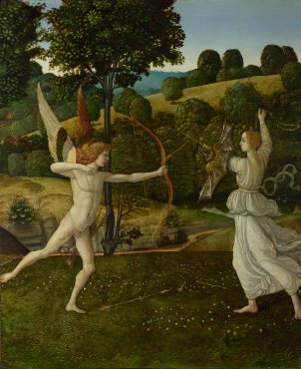
The Combat of Love and Chastity probably 1475-1500, Gherardo di Giovanni del Fora

