Slide 1
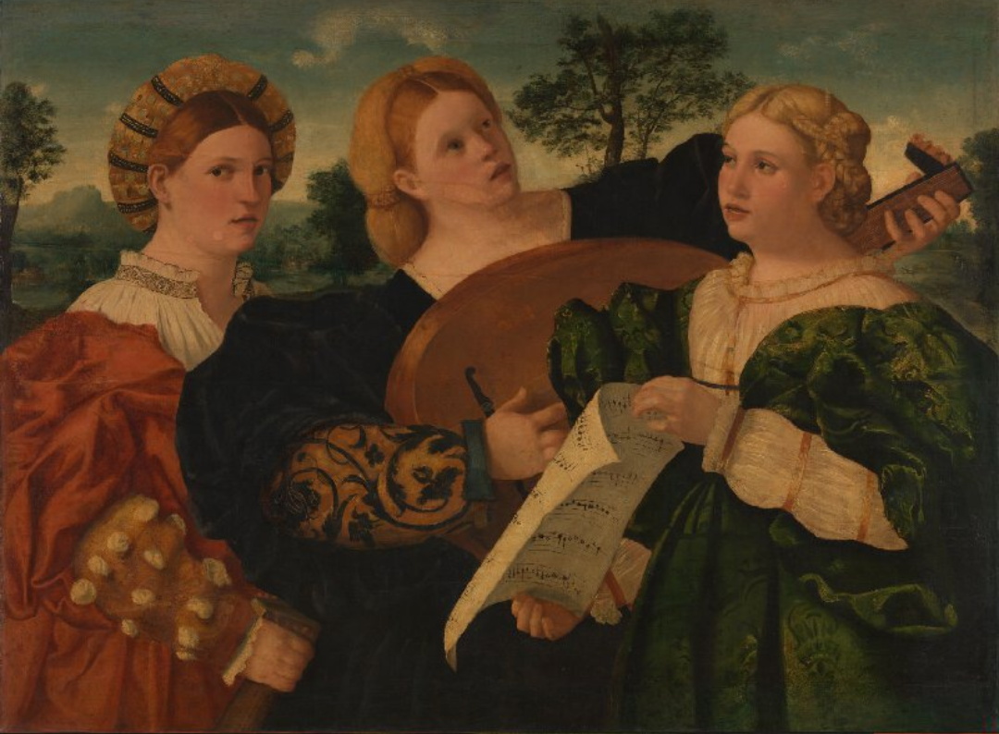
A concert, mid 1520, Italy

